Slide 1
Topic Modeling – Text Clustering
Aniket Chhabra

Slide 2
Agenda
Topic Modeling

Slide 3
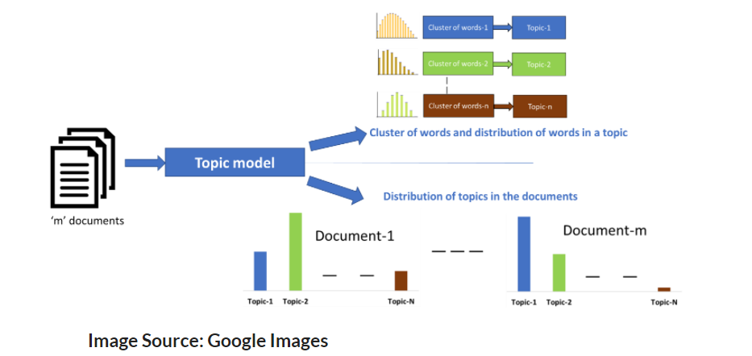
Background and Objective
Topic modelling tries to figure out which topics are present in the documents of the corpus and how strong the presence of those topics in documents are.
Goal
To extract hidden topical patterns that are present across the collection of documents.
Annotation of all the documents according to these topics.
With the help of annotations, we can organize, search and summarize texts.
Assumptions
Each document consists of more than one topics, and
Each topic consists of a collection of words.

Slide 4

Do we know the topics beforehand?

Slide 5
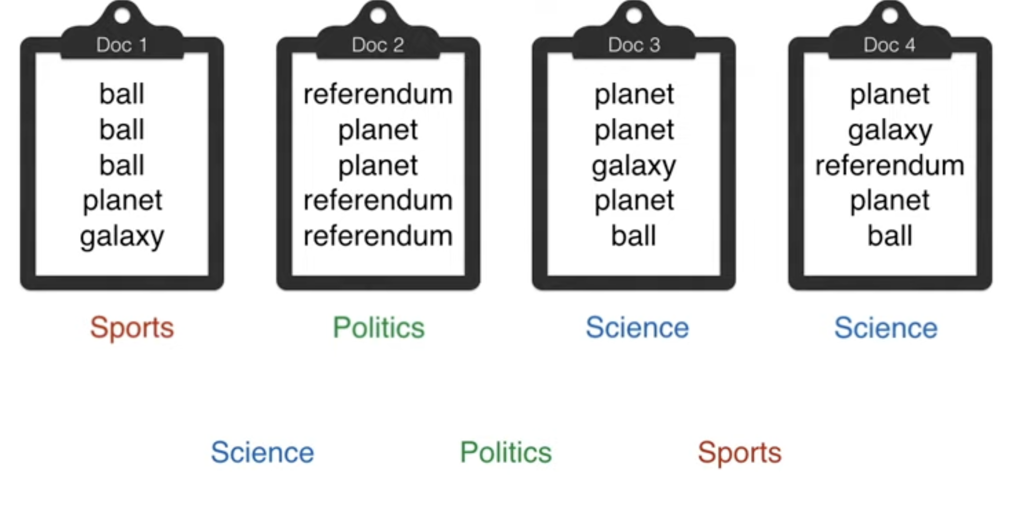
Can a machine do the same?

Slide 6
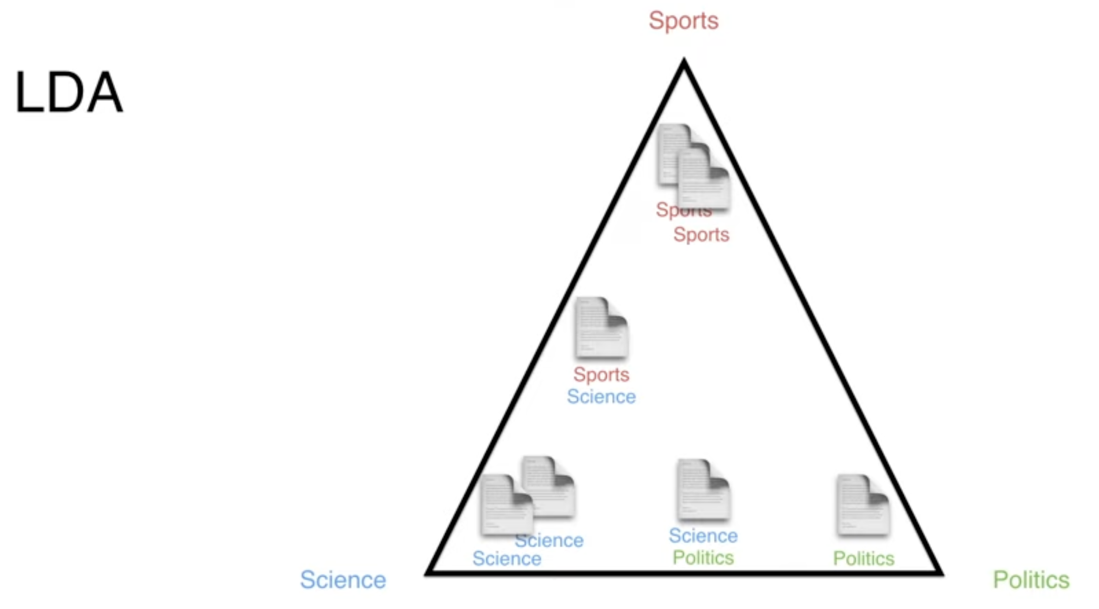
Topics assigned to the corner they belong to

Slide 7
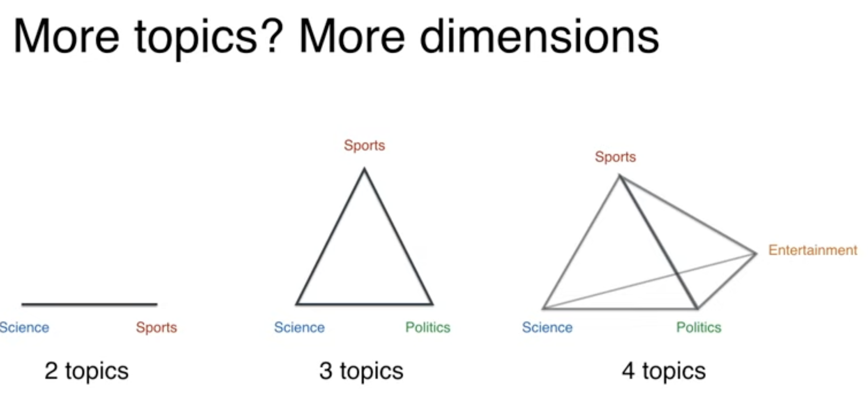

Slide 8
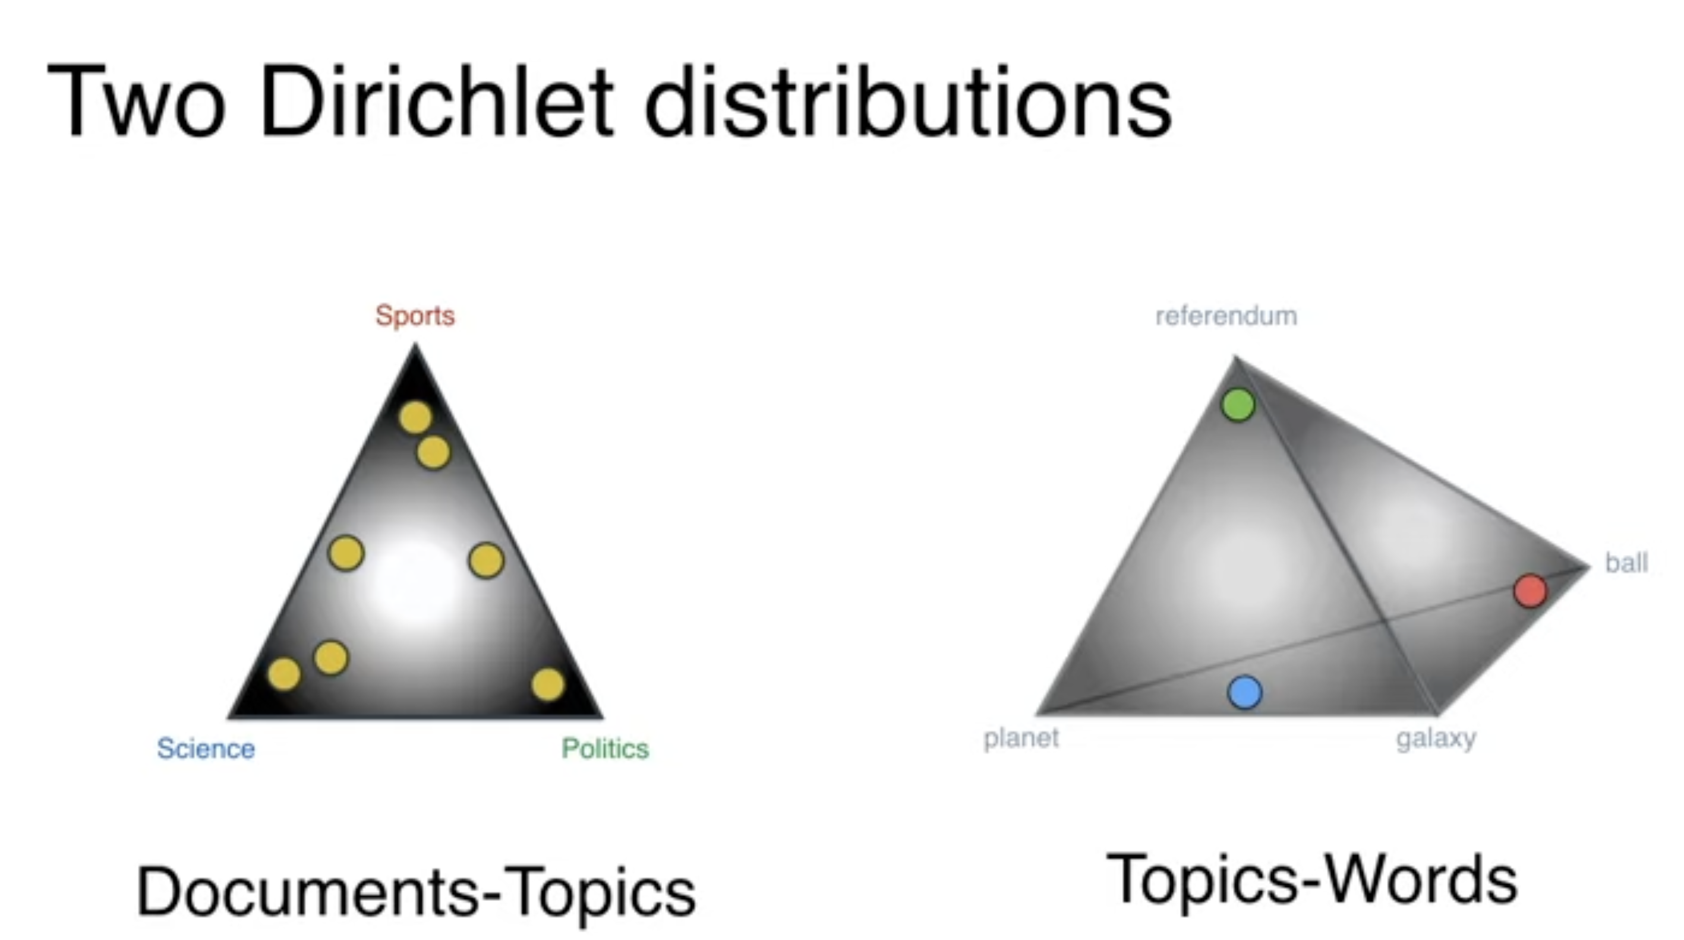

Slide 9
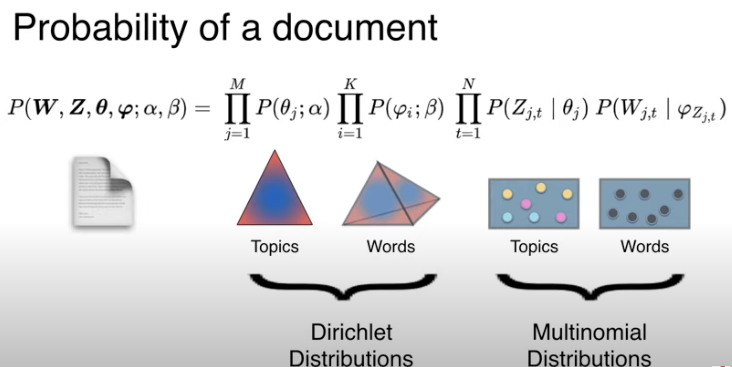

Slide 10
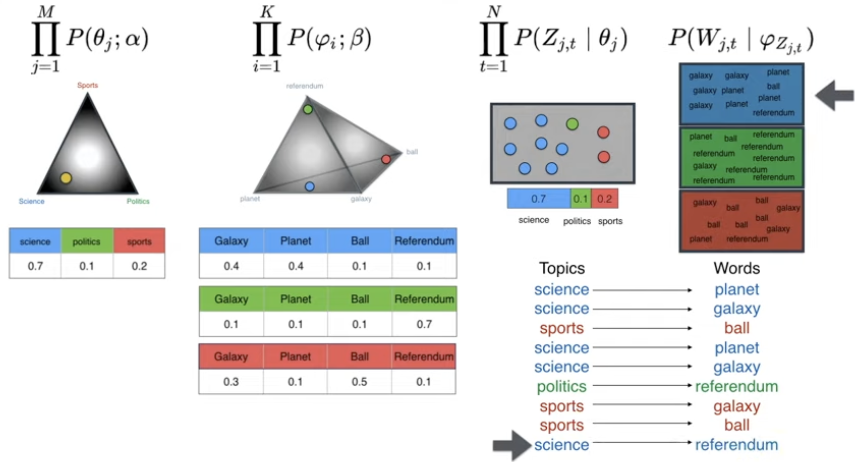

Slide 11
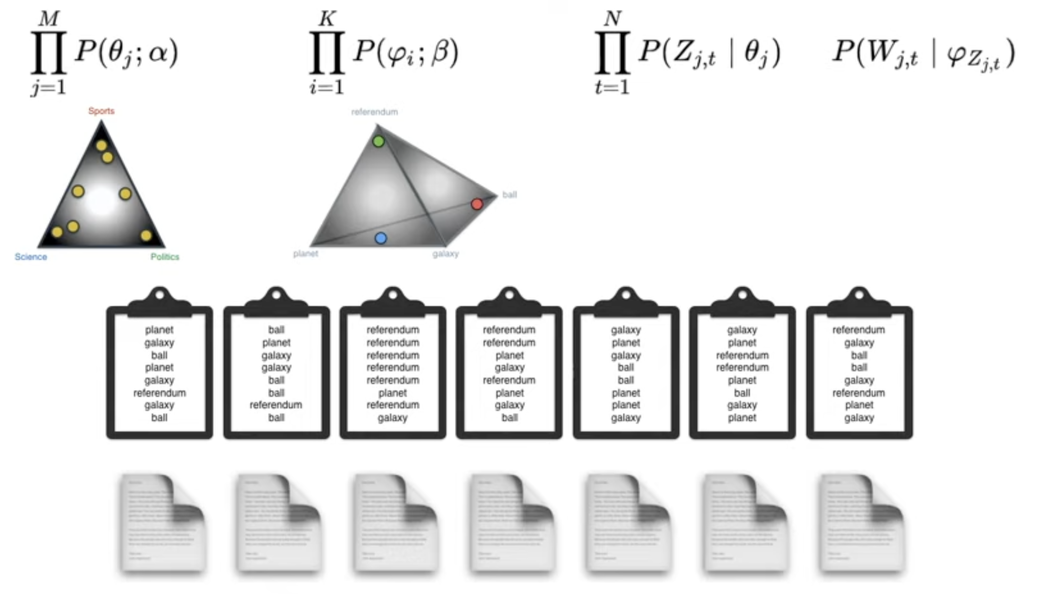

Slide 12
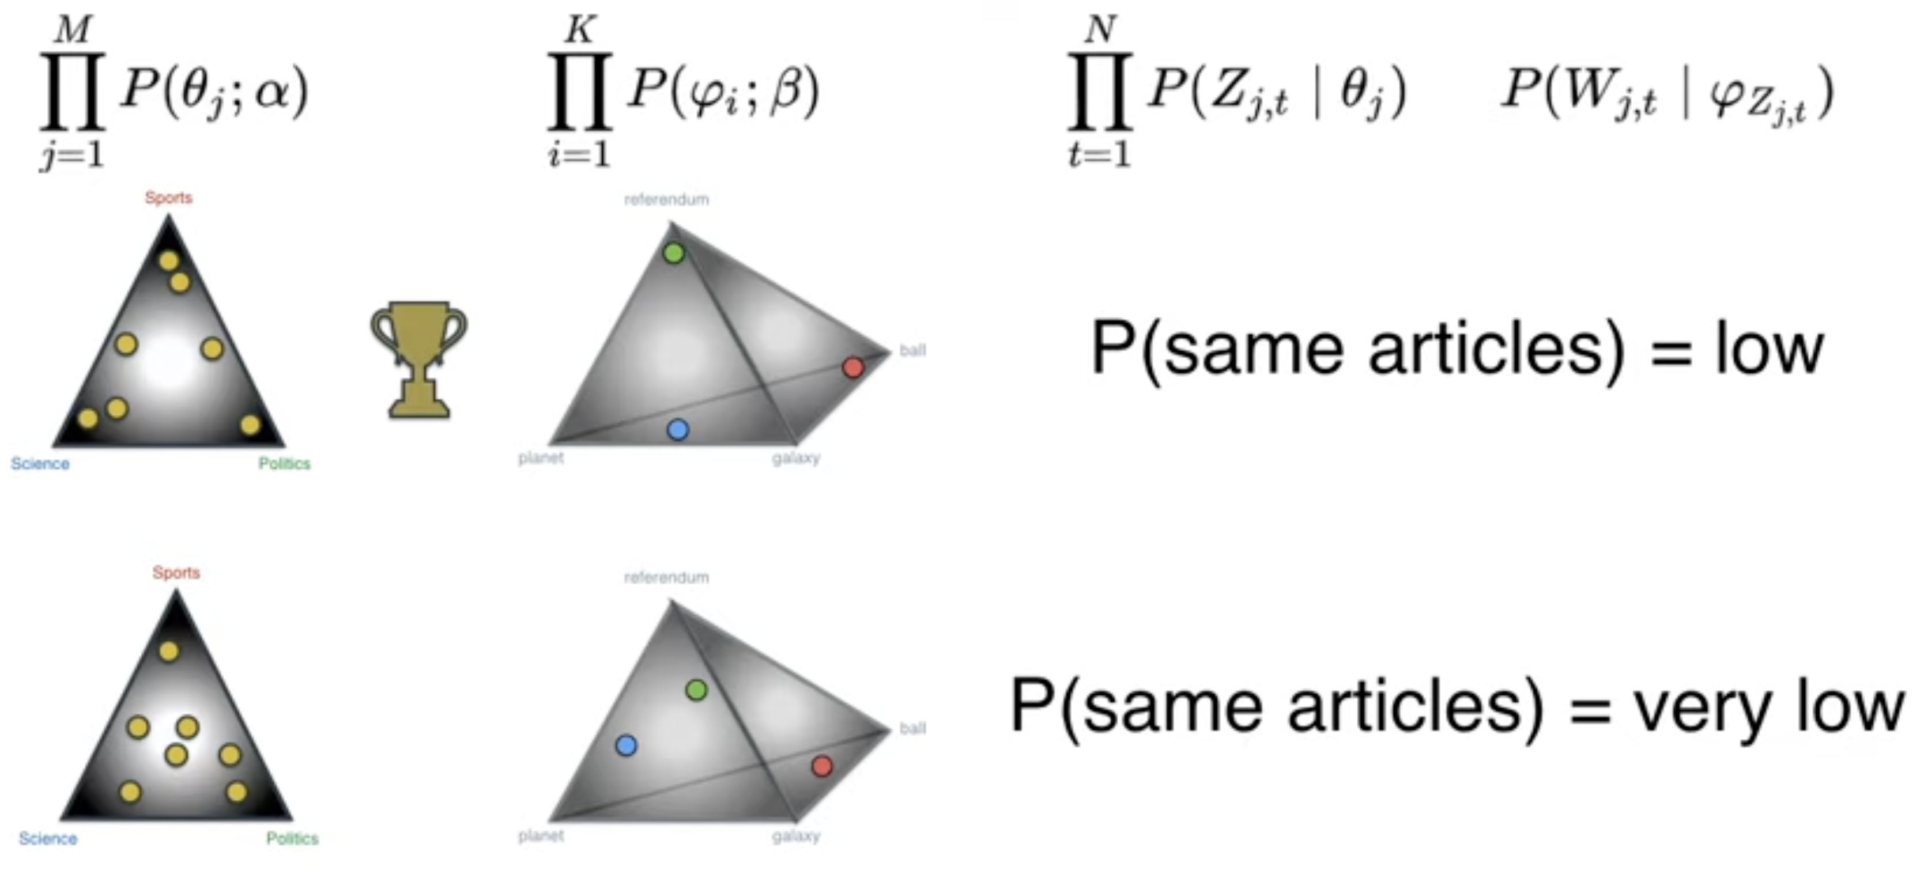

Slide 13
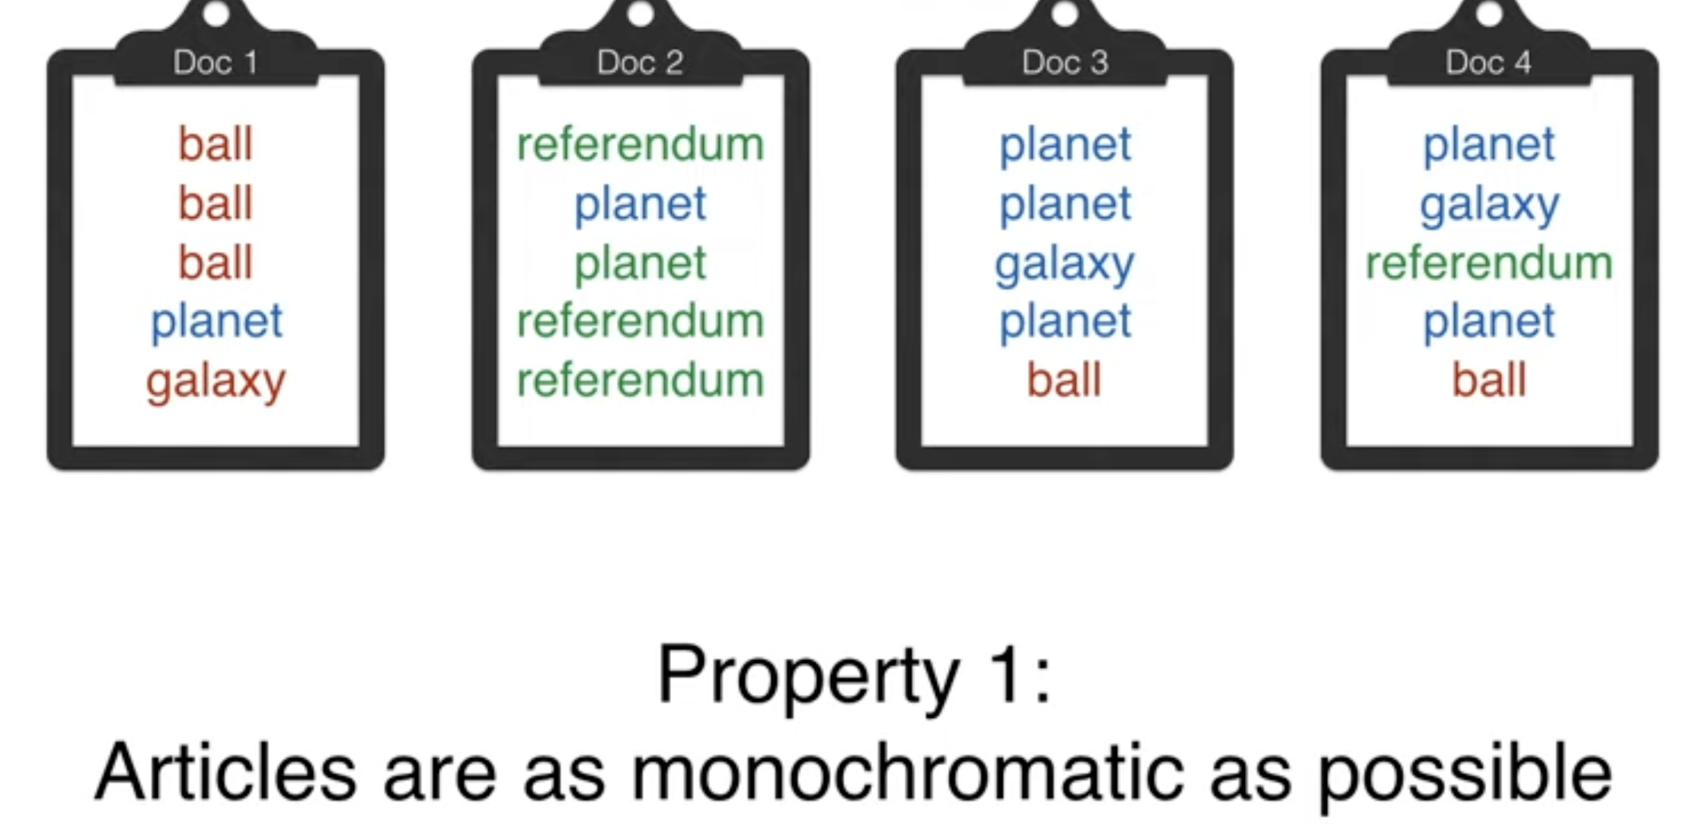
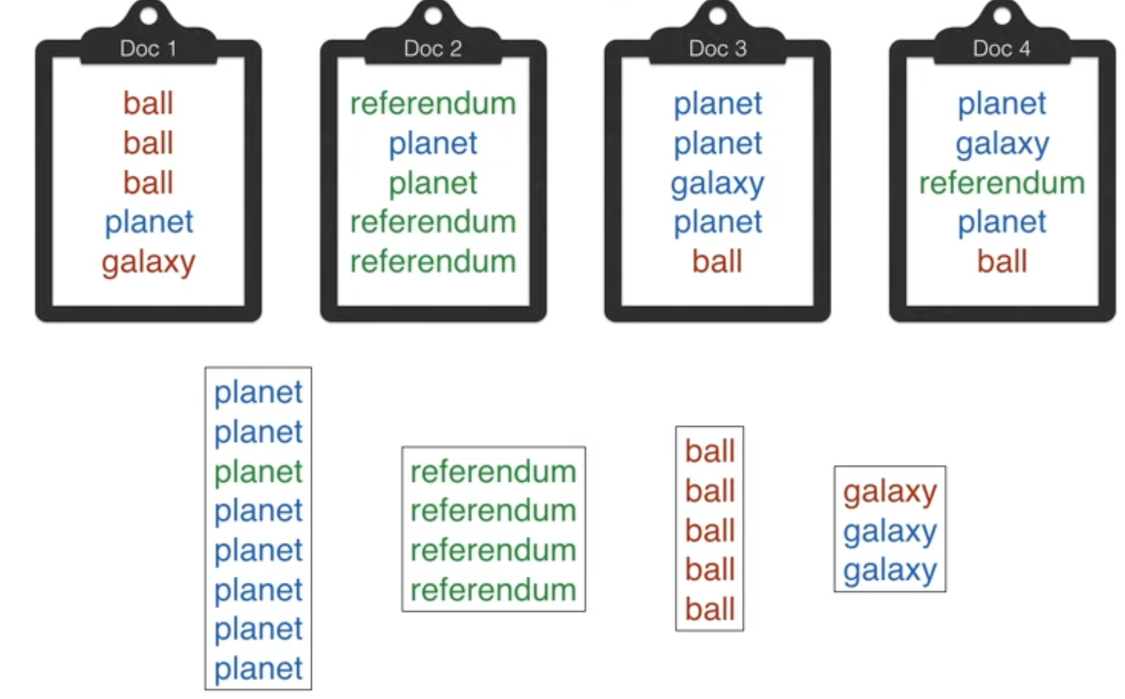

Assuming we will have max 3-4 colors/topics in the data.
Having too many topics/colors create noise in the data
Property 2:
What is the Goal here?

Slide 14
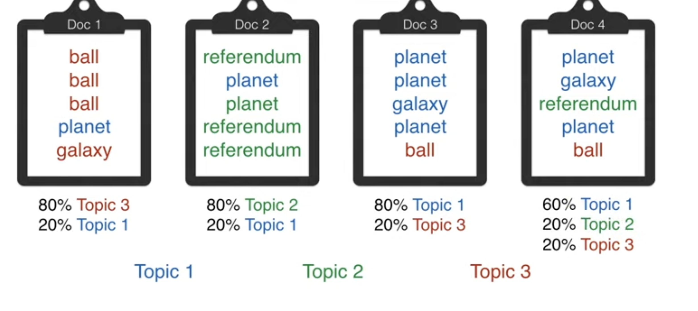

Slide 15
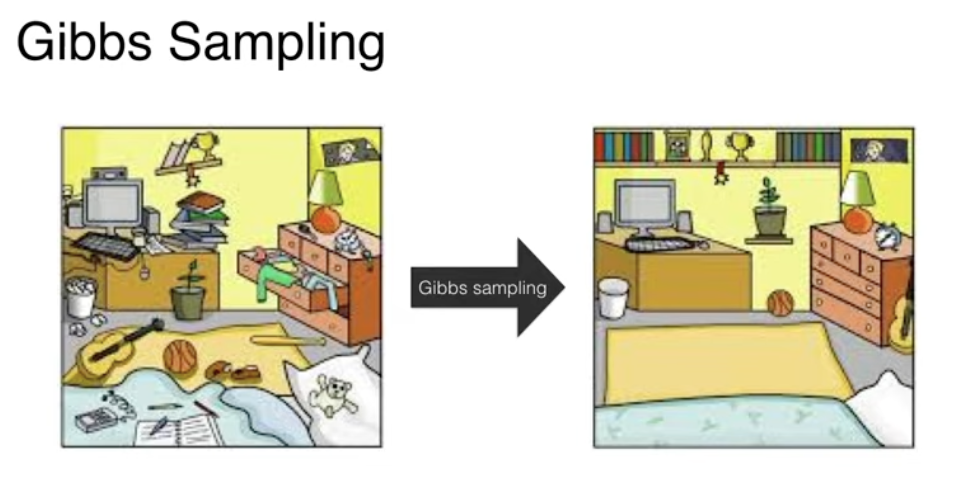

Slide 16
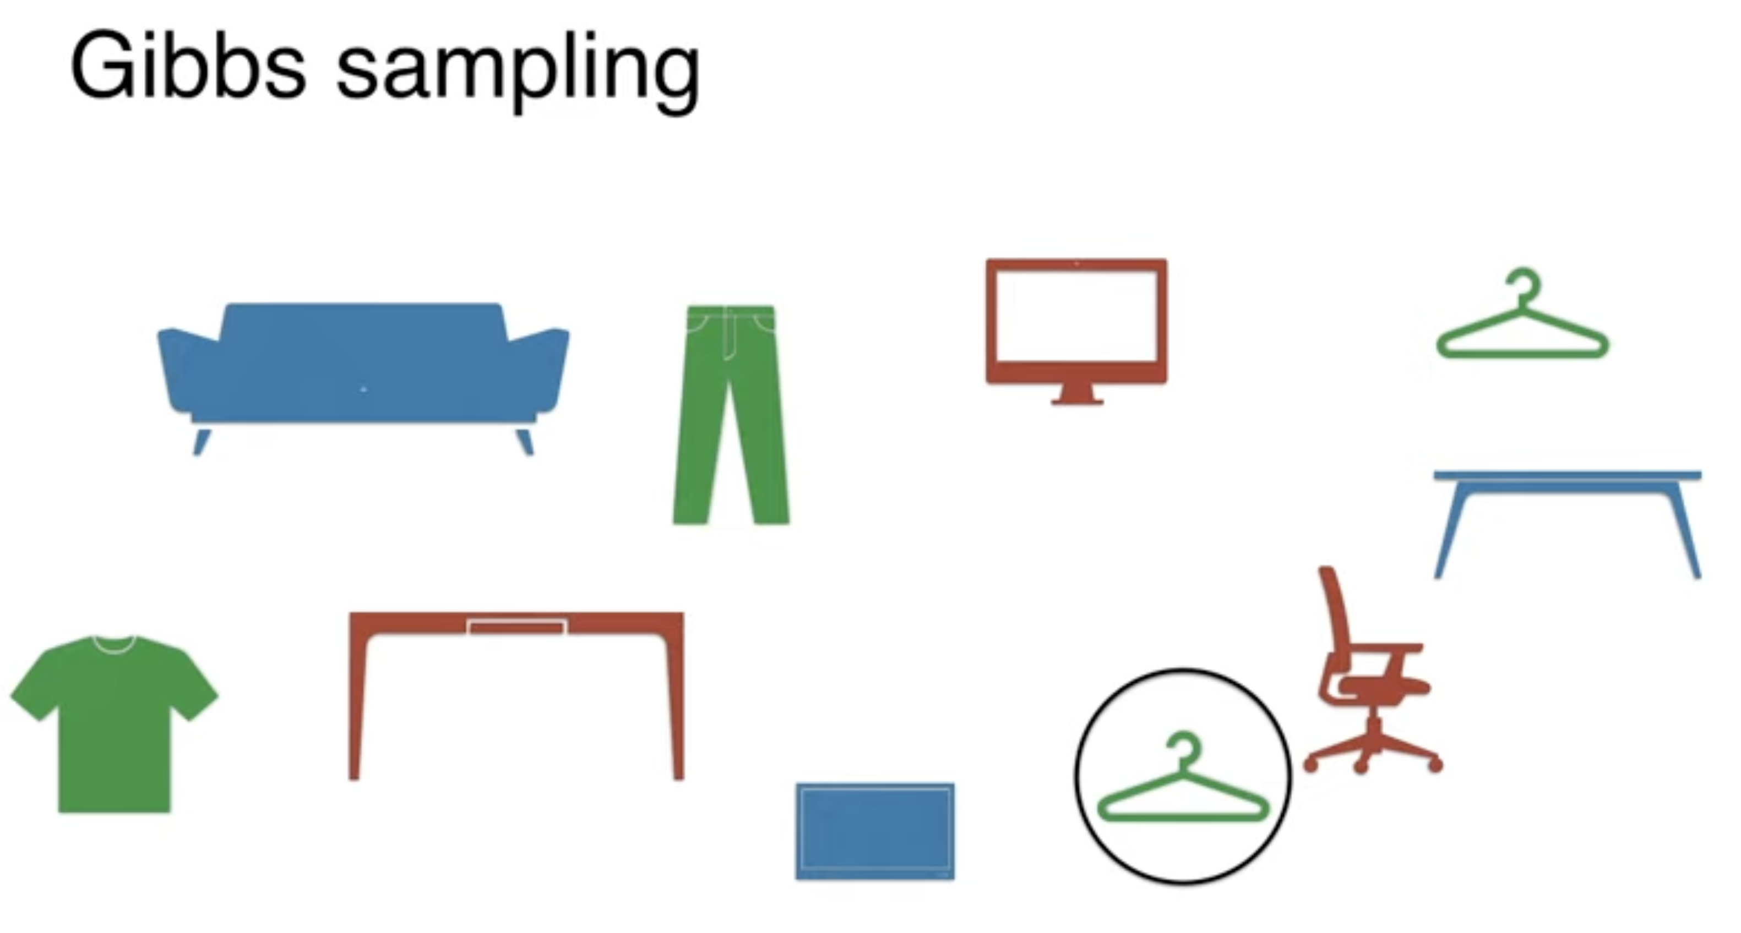


Slide 17
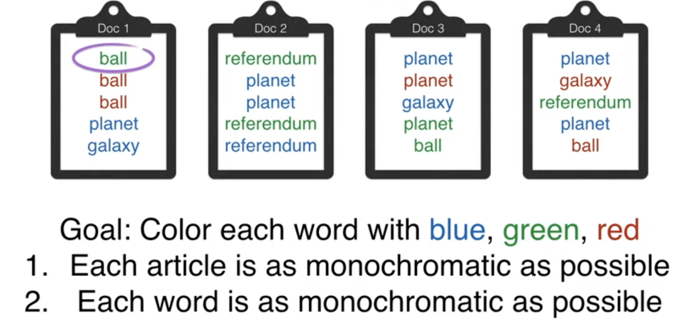

Slide 18
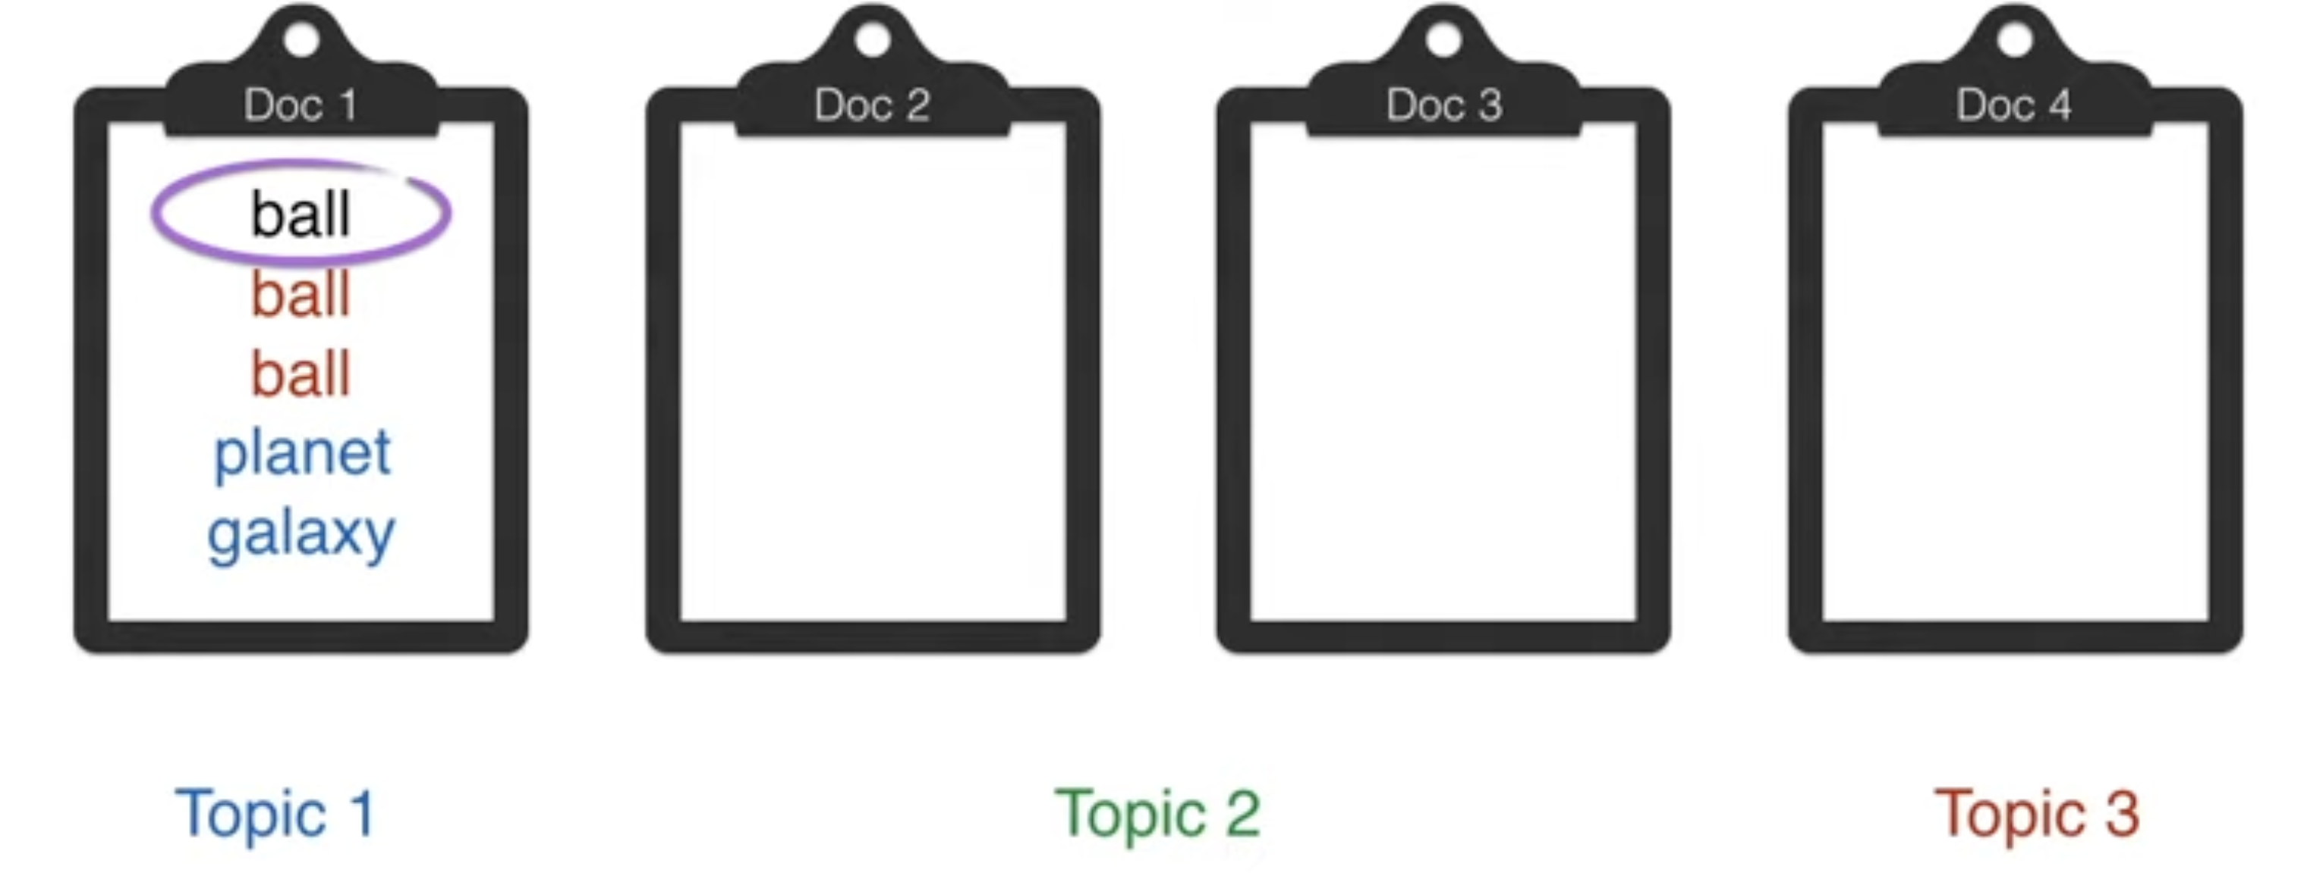
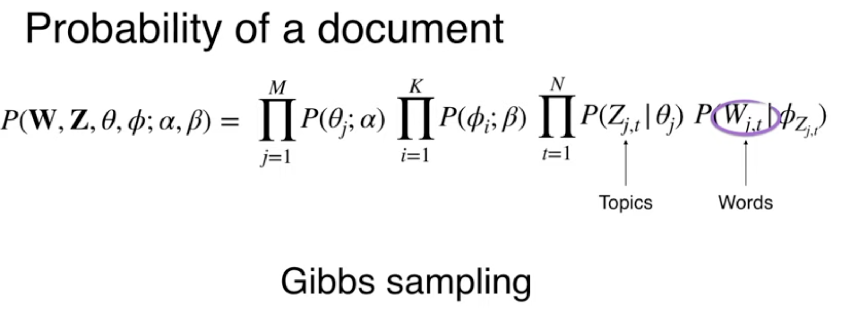
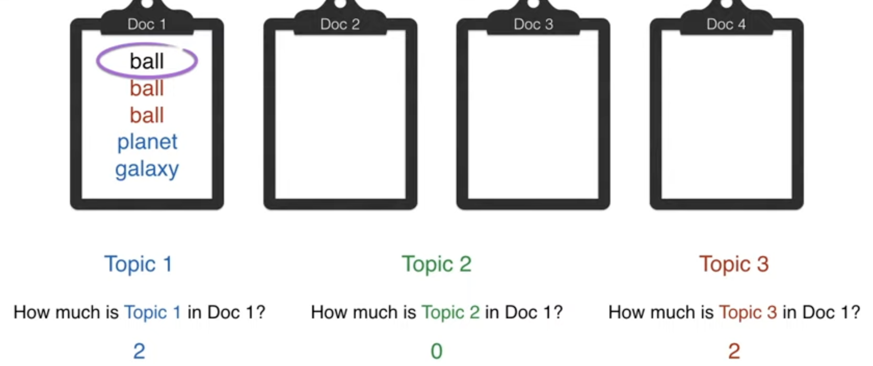
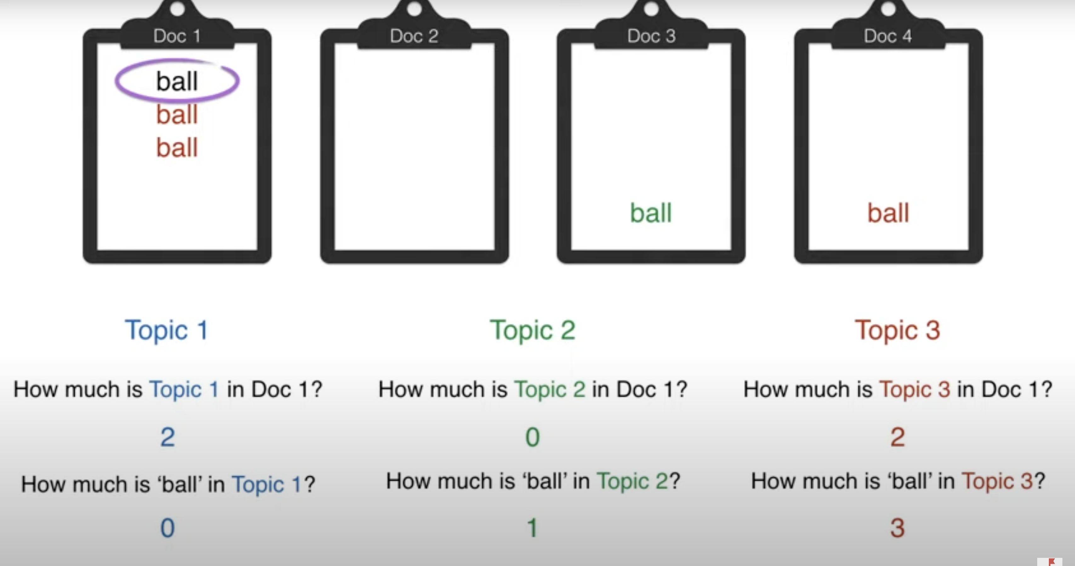
Let’s only look at document 1 – What color we should assign to the word ‘ball’ in document 1?
Either blue or Red but no green
Looking at only ball word across docs tell us about ‘Red’

Slide 19
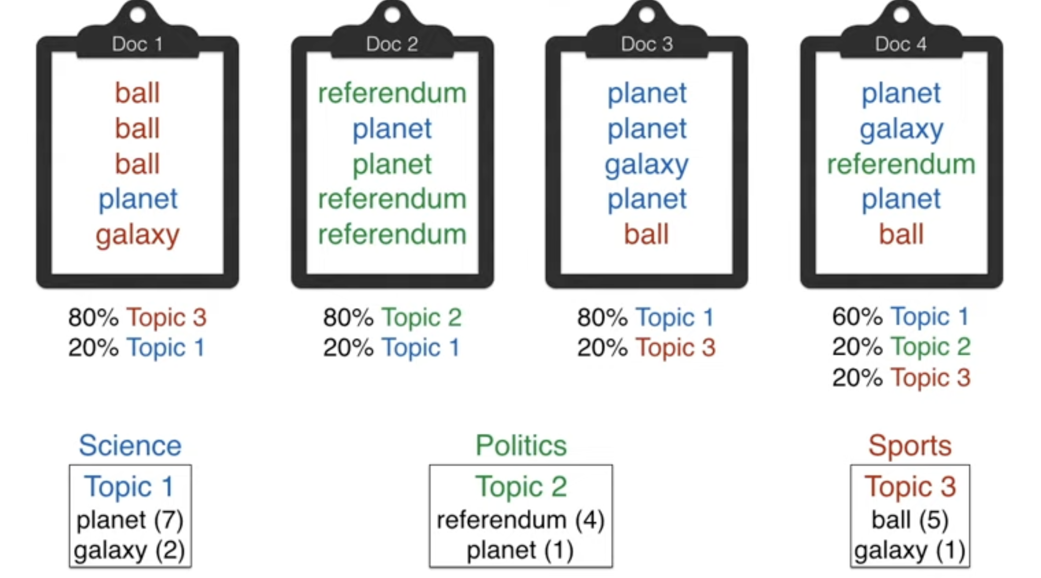

Slide 20
Appendix

Slide 21
Q&A

